Slide 1
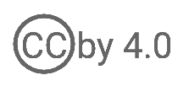
User Provisioning
WSO2 Identity Server Fundamentals

Slide 2
What is User Provisioning?
The process of creating and maintaining digital identities (user accounts) in a system and assigning appropriate privileges to them.

Slide 3
User Provisioning in the Identity Lifecycle
Provisioning
Create user account/identity
Assign roles
De-Provisioning
Authentication
Revoke access rights
Delete account
Validate user identities
Self-Service
Authorization
Password reset
Manage user info
Grant access
Manage permissions

Slide 4
Other User Provisioning Features
Audit trails and reports
Notifications
Self-service operations
Creating groups
Replicating organizational structure
Provisioning and de-provisioning services

Slide 5
Benefits of Using User Provisioning
Saves time and money
Improved security
Seamless integration
Improved compliance
Reduced IT costs
Enhanced visibility and control
Support for multiple systems and applications

Slide 6
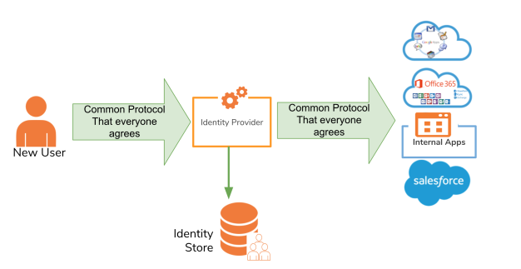
User Provisioning Standards
System for Cross-Domain Identity Management (SCIM)

Slide 7
User Provisioning Methods

Slide 8





Inbound Provisioning
Provisioning users and groups from external applications
Userstore
New User: John Doe
[Profile Picture, Address, Email]
User
[Profile Picture, Address, Email]
Application
Identity Provider (IdP)

Slide 9
Outbound Provisioning
Provisioning users and groups into external applications
Userstore
Userstore
User in Internal System
[Profile Picture, Address, Email]
New User: John Doe
[Profile Picture, Address, Email]
Identity Provider (IdP)
External Application

Slide 10


JIT Provisioning
Creating users in a local user store using the data extracted from a federated IdP within the federated authentication flow
Local IdP
User Store
New User: John Doe
[Profile Picture,
Address, Email]
External IdP
External IdP User Meta Data
[Profile Picture,
Address, Email]
Application
Federated IdP
User Store
Identity Provider (IdP)
Application User
[John Doe]

Slide 11
Provisioning Capabilities in WSO2 Identity Server
SCIM APIs
Using the administrative portal
Self registration portal
Self-registration API
Just-In-Time (JIT) provisioning
Provisioning connectors

Slide 12
Quick Recap

Slide 13

Overview of user provisioning
Benefits of using user provisioning
User provisioning standards
User provisioning methods
What you learnt

Slide 14



Any Questions ?
Reach us through the following channels
iam-dev@wso2.org
https://stackoverflow.com/questions/tagged/wso2-identity-server
https://discord.com/invite/Xa5VubmThw

Slide 15
Thank you!
Notes:
Acknowledge that it’s been a lot of changes within the team
Thank you for your taking onboard the feedback and being open to change.
A lot of work , a lot of learning, sometimes feeling twice the exhaustion
But also hopefully seeing what I see, which is: better ways of working, more innovation in our approach, more business acumen, more effective reactivity , more ahead of the game. Because that’s where marketing needs to be.
All this in a context where it’s also been a lot of changes for WSO2.
And from this standpoint I wanted to remind you of what Sanjiva said about you owning the culture

